Slide 1
JAVA Programming{
Hiveed.java
JAVA PROGRAMMING ;
/* Here is where your journey for your dream begins */
}
JAVA Programming

Slide 2
Table Of ‘Contents’ {
01
02
03
Hiveed.java
Syntax ;
Class ;
Methods ;
04
Packages ;
}
JAVA Programming

Slide 3
Syntax :
Hiveed.java
Every programming language has its own syntax as well as human language.
Java Syntax is a basic of the language, all the main rules, commands, constructions to write programs that the compiler and computer “understands”.
It provides a way to write algorithms, specify data structures, and control the flow of execution to perform required tasks.
JAVA Programming

Slide 4
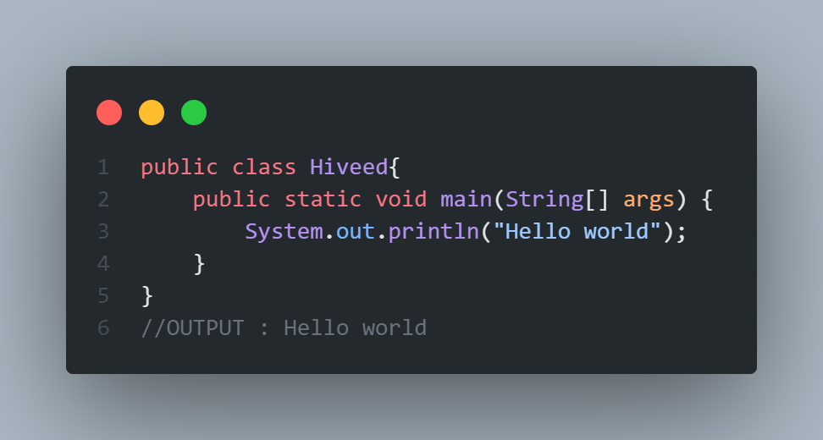
Class :
Hiveed.java
A class is a basic building block. It can be defined as template or Blueprint.
Class is used to initialize the object.
For example, an Employee class may contain all the employee details in the form of variables and methods.
JAVA Programming

Slide 5
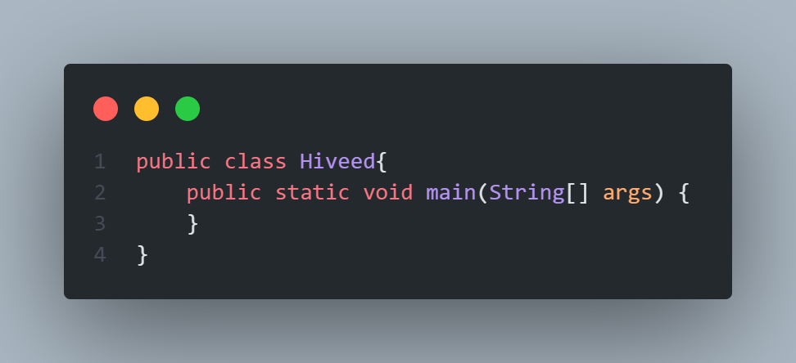
Methods :
Hiveed.java
A method is a block of code ehich only runs when it is called.
You can pass data , known as parameters ,into a method.
Methods are used to perform certain actions,and they are also known as functions.
JAVA Programming

Slide 6
Main Method :
Hiveed.java
Public :
It is an access specifier. We should use a public keyword before the main() method so that JVM can identify the execution point of the program.
If we use private, protected, and default before the main() method, it will not be visible to JVM.
JAVA Programming

Slide 7
Main Method :
Hiveed.java
Void :
Java, every method has the return type. Void keyword acknowledges the compiler that main() method does not return any value.
JAVA Programming

Slide 8
Main Method :
Hiveed.java
Static :
You can make a method static by using the keyword static. We should call the main() method without creating an object. Static methods are the method which invokes without creating the objects, so we do not need any object to call the main() method.
JAVA Programming

Slide 9
Main Method :
Hiveed.java
main :
It is a default signature which is predefined in the JVM. It is called by JVM to execute a program line by line and end the execution after completion of this method. We can also overload the main() method.
JAVA Programming

Slide 10
Main Method :
Hiveed.java
String[] args :
The main() method also accepts some data from the user. It accepts a group of strings, which is called a string array. It is used to hold the command line arguments in the form of string values.
Here, agrs[] is the array name, and it is of String type.
JAVA Programming

Slide 11
Packages {
Hiveed.java
In small projects all the java files have unique names . so,it is not difficult to put them in a single folder.
But in the case of huge project where number of java files is large, it is very difficult to put files in a single folder.
It is not possible t store two java files with same name in the same folder because it may occur naming conflict.
}
JAVA Programming

